Slide 1

Data Science Salaries
MySQL analysis

Slide 2
INTRODUCTION
This presentation is about Data Science Salaries Datasets
The aim is to look into the salaries of various job roles in the data.

Slide 3
OBJECTIVES
To show salary range by different job category as shown in the dataset
To show salary range by location
To show overall salary range: Minimum, Maximum and Average.
To show average salary range by company’s size

Slide 4
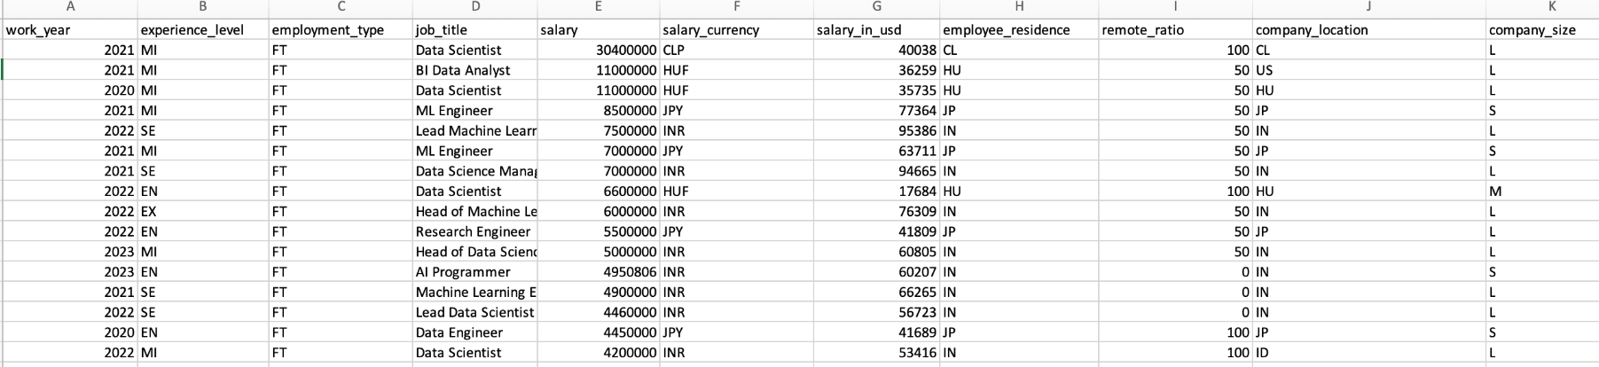
Dataset Description
This dataset contains the columns:
Work_year
Experience_level
Employment_type
Job_title
Salary
Salary_Currency
Salary_in_USD Employee_residence
Remote_ratio
Company_location
Company _size

Slide 5
Summary of Methodology
Cleaning and preparation
Data was cleaned and prepared using Microsoft Excel to remove duplicates, blanks and repetitions. Additionally spelling and grammar was checked. Before the data was cleaned there were 14837 rows and after cleaning there was 9182 rows.
Data Analysis
Analysis was conducted through MySQL. Analysis methods included filtering, calculations (average, count, addition, division, subtraction), using case statements, using conditional statements, using wildcard statements, general query syntax.

Slide 6
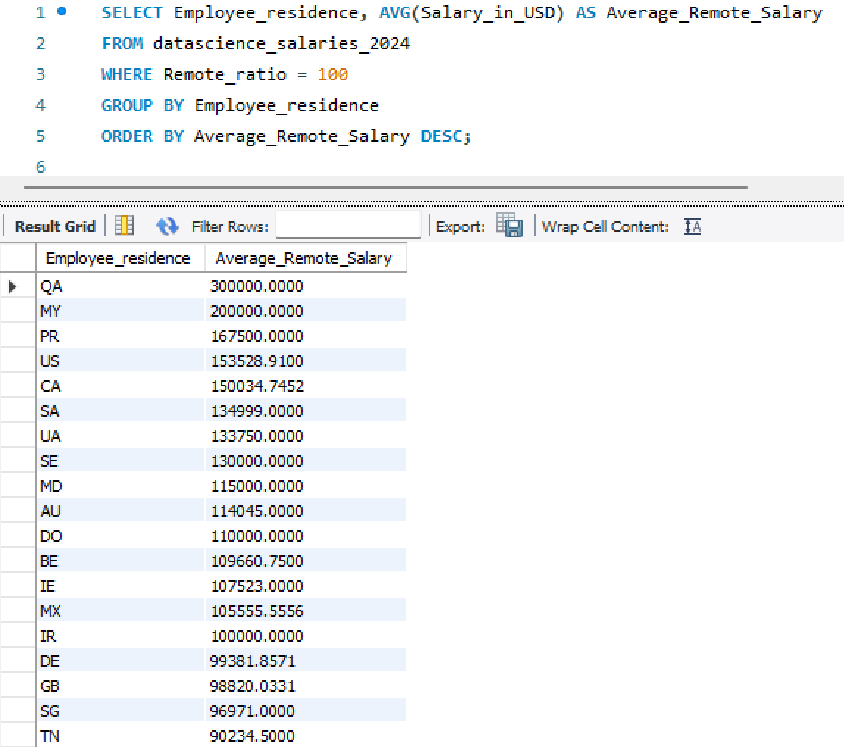
Highest Paying Locations for Remote Work
Qatar (QA) stands out as the highest-paying location for remote work with an average salary of $300,000, followed by Malaysia (MY) at $200,000 and Puerto Rico (PR) at $167,500. The United States (US) and Canada (CA) also rank highly, offering average remote salaries exceeding $150,000. The data highlights a significant variation in average remote salaries across different regions, with notable opportunities in both North America and select international locations such as Saudi Arabia (SA), Ukraine (UA), and Sweden (SE).

Slide 7
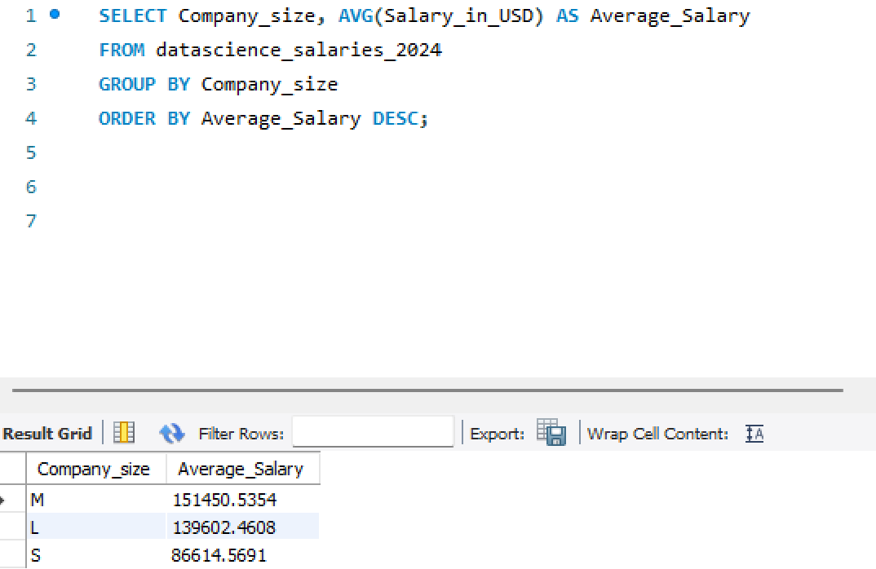
Average Salary by Company Size
Medium-sized companies (M) offer the highest average salary of $151,450.54, indicating that these organizations provide competitive pay compared to others.
Large companies (L) follow with an average salary of $139,602.46, slightly lower than medium-sized companies.
Small companies (S) offer the lowest average salary of $86,614.57, reflecting a significant gap compared to both medium and large companies.
This analysis suggests that medium-sized companies prioritize higher salaries, potentially to attract and retain top talent while maintaining a lean organizational structure. Small companies may face financial constraints, which could limit their ability to offer competitive salaries.

Slide 8
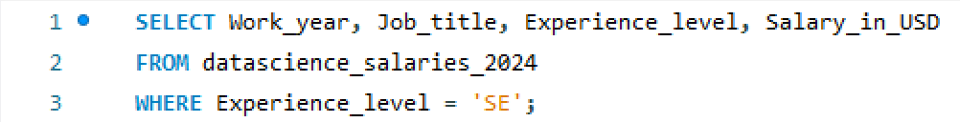
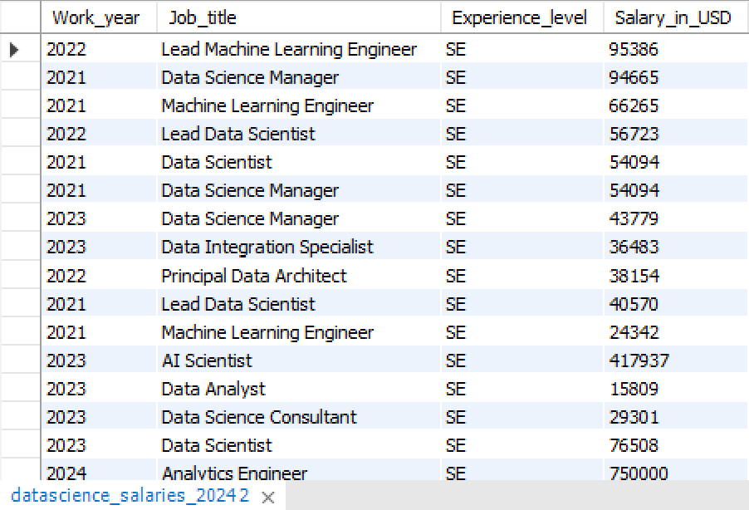
Filtering Senior Positions
This query provides insights into senior-level professionals (`SE`) within the organisation. Key findings include:
Senior-level roles vary across a wide range of job titles such as Lead Machine Learning Engineer, Data Science Manager, AI Scientist, and Analytics Engineer.
Salaries for these positions display significant variation, ranging from $15,809 for entry-level analytics-related roles to a high of $750,000 for the Analytics Engineer in 2024.
Some of the high-paying roles include AI Scientist with $417,937 and Lead Machine Learning Engineer with $95,386, highlighting the financial value of technical leadership roles.
The data spans multiple years (2021–2024), suggesting evolving trends in pay and role demand over time.
This analysis underscores the diversity of senior-level positions, their responsibilities, and their substantial salary differences, likely influenced by job title, specialisation, and market conditions.

Slide 9
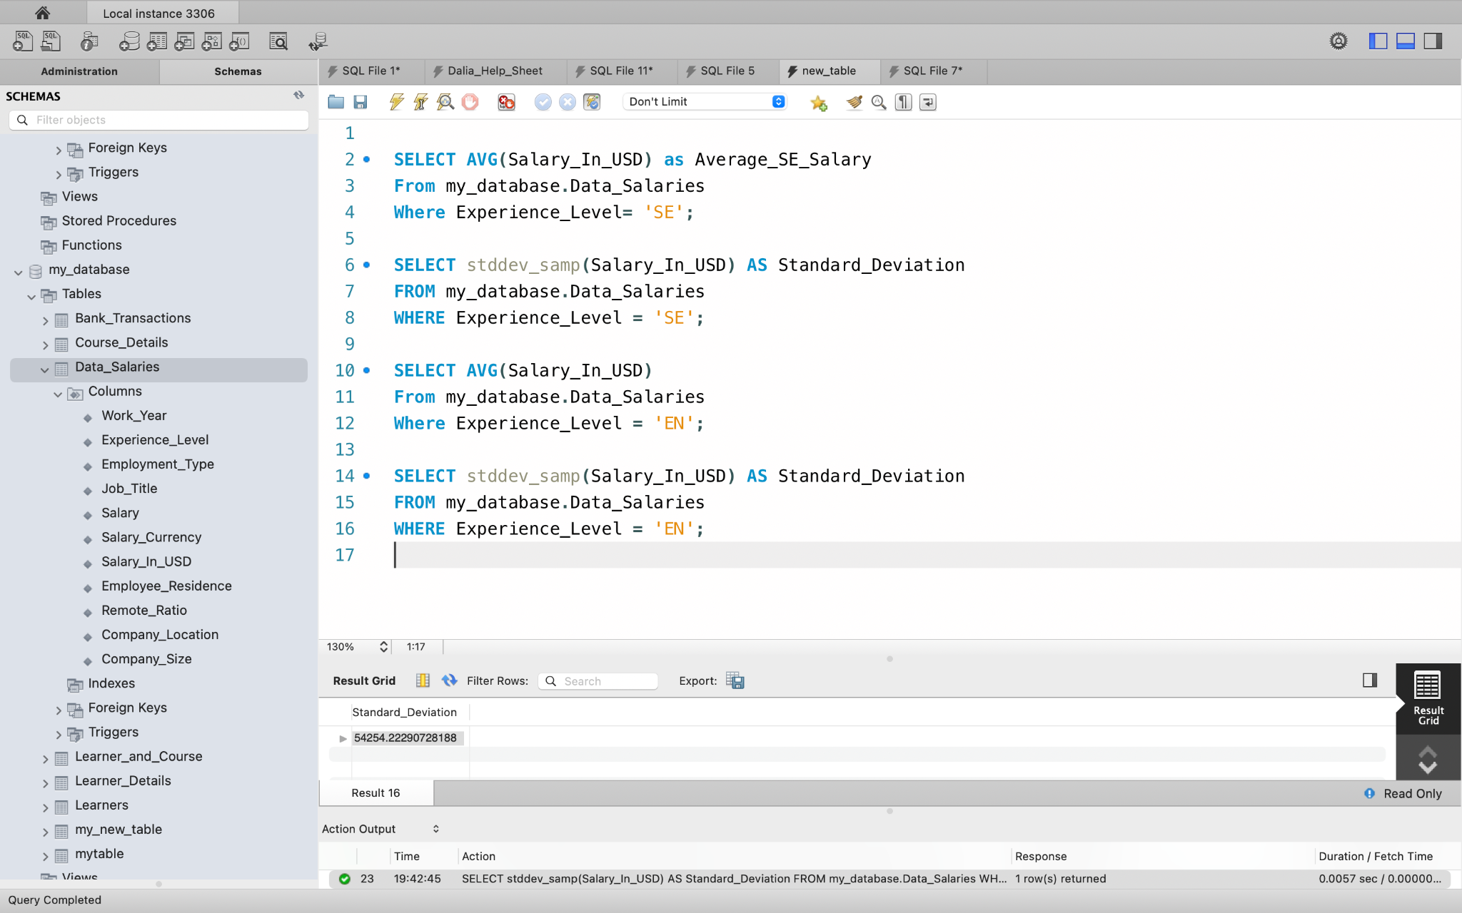
Senior Position Distribution of Salaries
The average salary among senior roles is $163,515.7172 USD.
The standard deviation among senior roles is $68,486.3 USD
The average salary among entry level roles is $90,049.2 USD
The standard deviation among entry level roles is $54,254.2 USD.

Slide 10
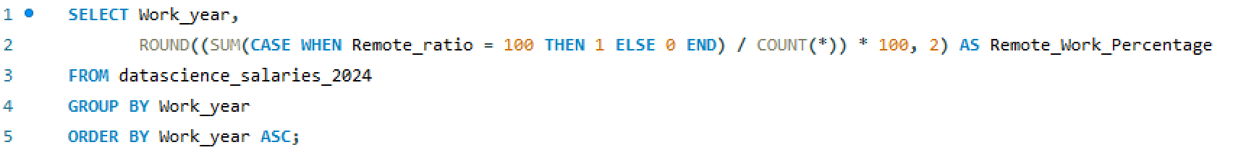
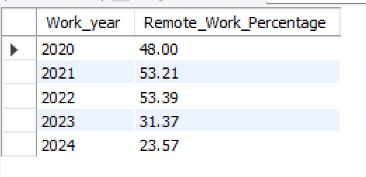
Conditional Aggregation in SQL
Using conditional aggregation with SQL queries, this analysis calculates the percentage of employees working fully remotely for each year, highlighting trends in workforce flexibility and adaptation over time.

Slide 11
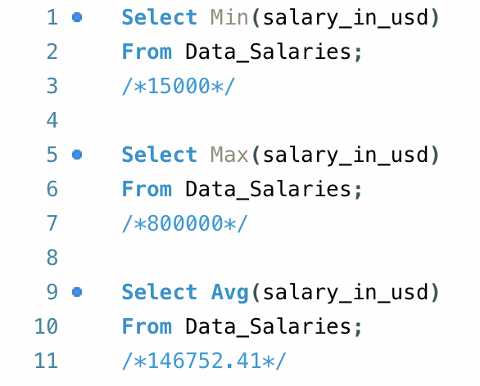
Minimum, Maximum, and Average Salary
To investigate the distribution of salaries among employees.
Calculate the range (minimum and maximum) of Salary that employees earn.
The minimum amount = $15,000
The maximum amount= $800,000
The average amount= $146,752.41

Slide 12
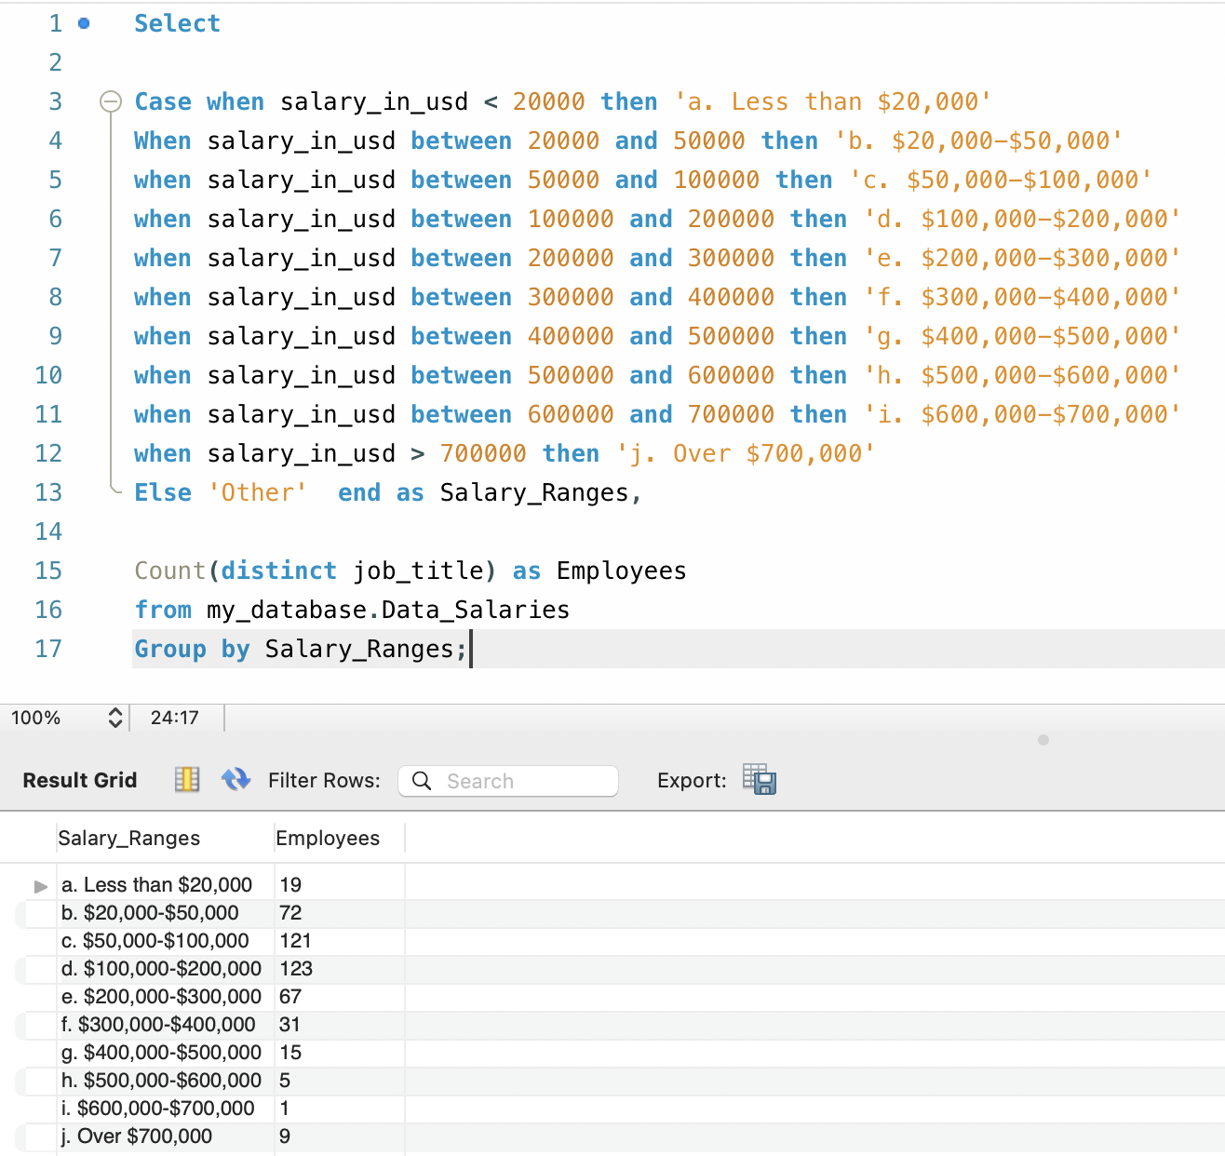
Number of Employees per Salary Ranges
Using a case statement, we can catagorise the number of employees per salary bracket.
The largest frequency of employees had a salary between $100k-$200k which is consistent with the calculated mean.

Slide 13
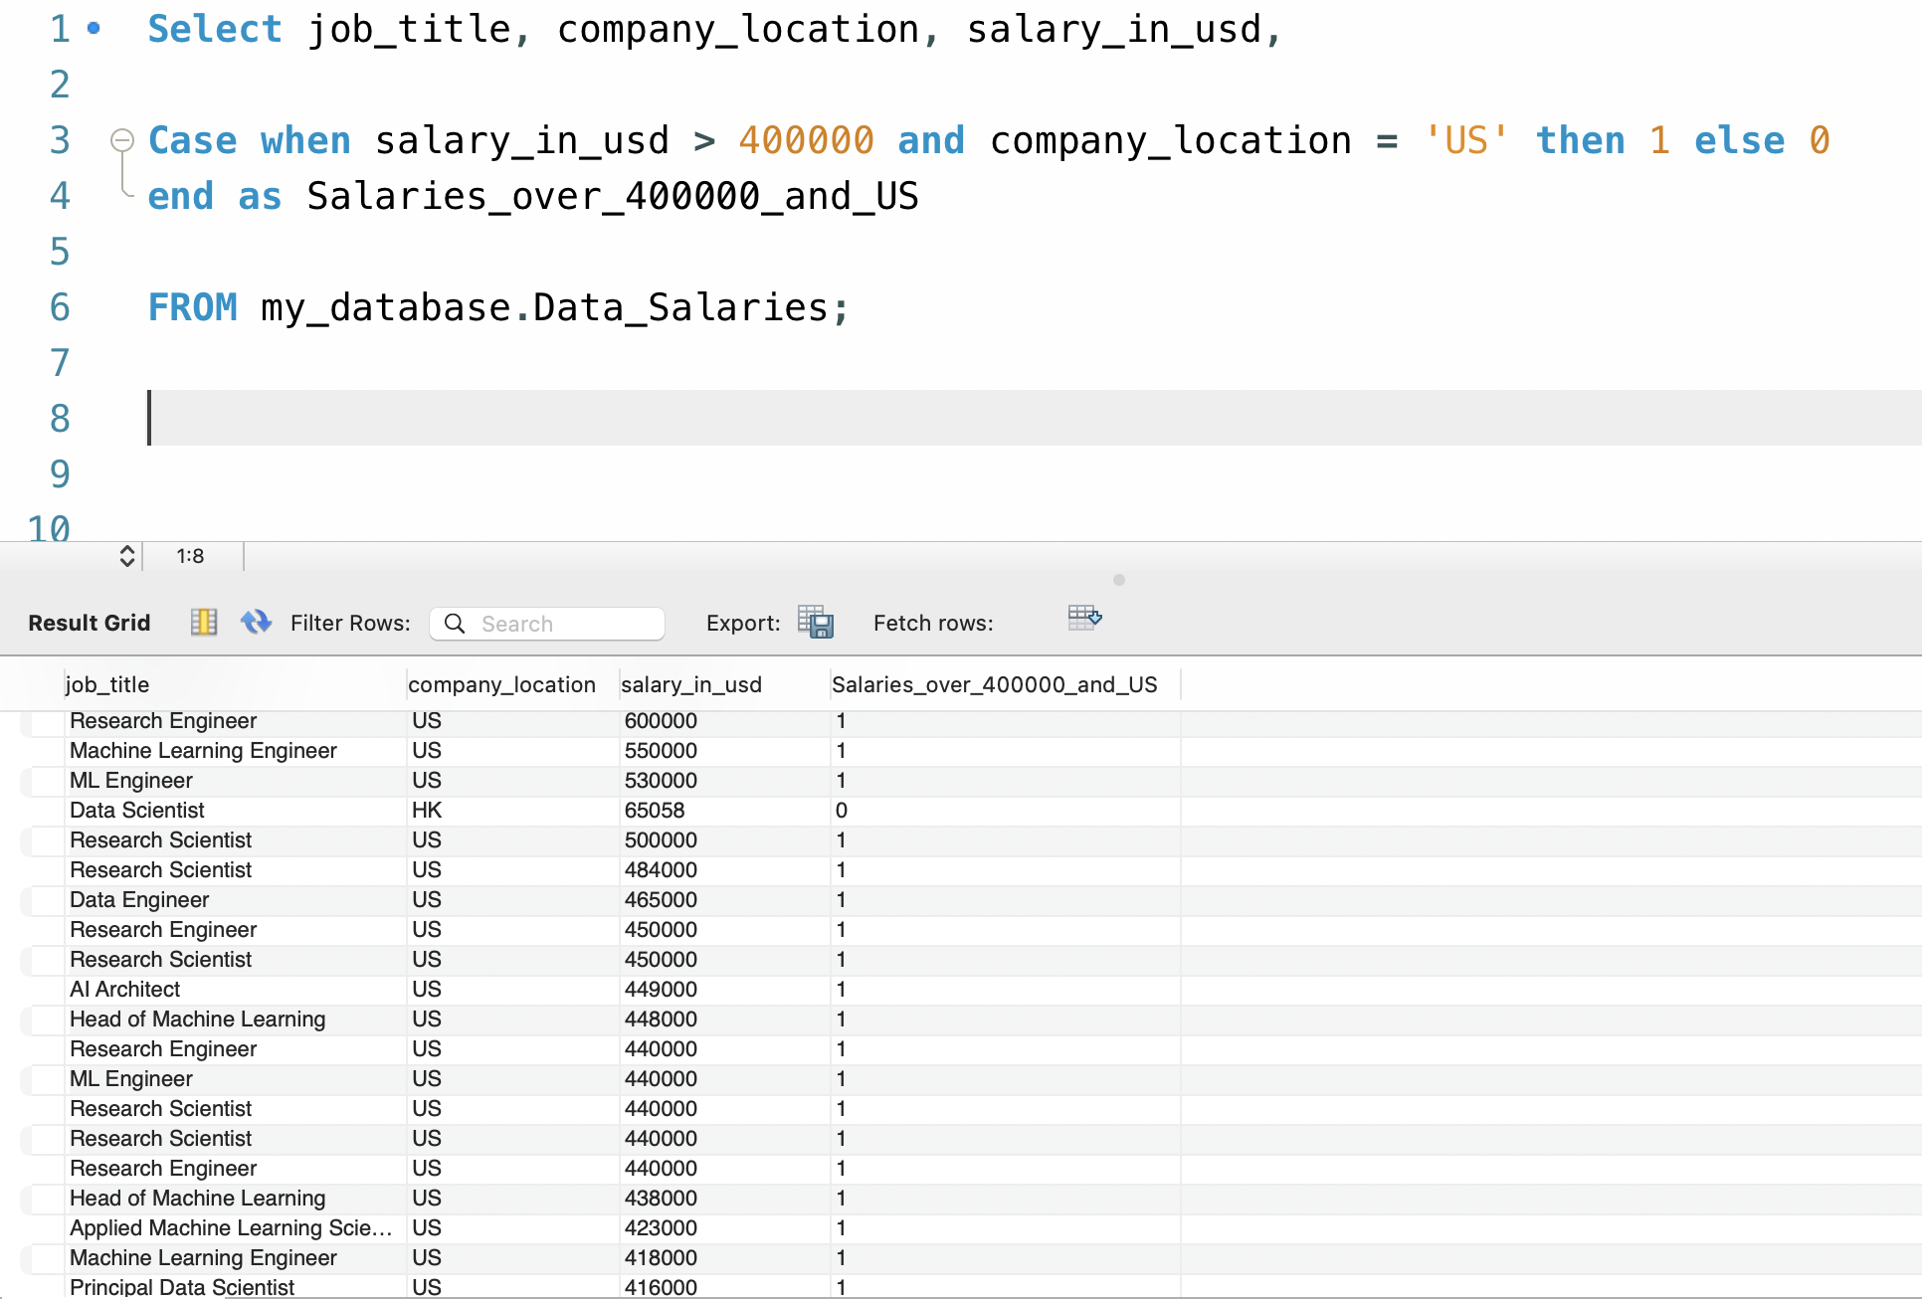
Flagging Employees that earn >$400,000
Employees that satisfy certain conditions of a case statement can be identified by creating a ‘flag’.
In this example, we are finding employees that make more than $400,000 and their company location is the US, which are marked by a 1.
This can be changed to any boolean data format (YES/NO or TRUE/ FALSE).

Slide 14
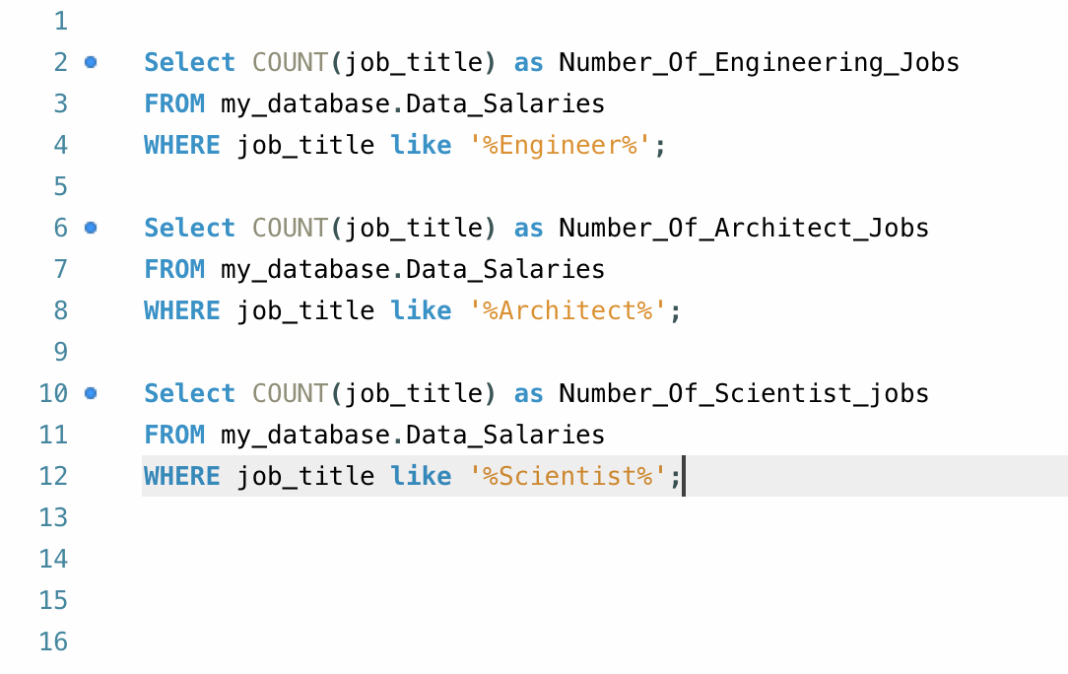
Counting Types of Jobs
Using both count and wildcards,we can count the number of jobs in fields of Engineering, Architecture, and Science among others.
The number of jobs for each of these disciplines:
Engineering= 6224
Architecture= 402
Science= 4114
This provides the company with more insight into how many fields are being occupied than others.

Slide 15
Results

Slide 16
Summary of Results
The Percentage of Remote workers
The number of remote workers increased from 2020 and then gradually decreased from 2022. In 2020 48% of workers were remote, which gradually increased to 53% in both 2021 and 2022. Then the percentage of remote workers decreased to 31.4% in 2023 and to 23.6% in 2024.
The minimum, maximum and average salaries
It was found that the minimum salary that was available was $15,000, the maximum amount that was achieved was $800,000 and the average salary from the data provided was $146,752.41.

Slide 17
Summary of Results continued
3.) The distribution of employees within different salary brackets
The distribution of employees that have salaries between $15,000 and $800,000 shares a similar structure to a bell-curve. It was found that 19 people made less than $20,000, 72 employees made more than $20,000 and less than$50,000, 121 employees made more than $50,000 and less than $100,000, 123 employees made more than $100,000 and less than $200,000, 67 employees made more than $200,000 and less than $300,000, 31 employees made more than $300,000 and less than $400,000, 15 employees made more than $400,000 and less than $500,000, 5 employees made more than $500,000 and less than $600,000, 1 employee made more than $600,000 and less than $700,000. Surprisingly 9 employees made more than $700,000. This indicates that most employees make between $100,000- $200,000.
4.) The number of job disciplines.
It was found that within the engineering, architecture and science disciplines there were 6224 engineering roles, 4114 scientist roles and 402 architecture roles.

Slide 18
Summary of Results continued
5.) Highest Paying Locations for Remote Work
Qatar (QA) stands out as the highest-paying location for remote work with an average salary of $300,000, followed by Malaysia (MY) at $200,000 and Puerto Rico (PR) at $167,500. The United States (US) and Canada (CA) also rank highly, offering average remote salaries exceeding $150,000. The data highlights a significant variation in average remote salaries across different regions, with notable opportunities in both North America and select international locations such as Saudi Arabia (SA), Ukraine (UA), and Sweden (SE).
6.) Average Salary by Company Size
Medium-sized companies (M) offer the highest average salary of $151,450.54, indicating that these organizations provide competitive pay compared to others.
Large companies (L) follow with an average salary of $139,602.46, slightly lower than medium-sized companies.
Small companies (S) offer the lowest average salary of $86,614.57, reflecting a significant gap compared to both medium and large companies.
This analysis suggests that medium-sized companies prioritize higher salaries, potentially to attract and retain top talent while maintaining a lean organizational structure. Small companies may face financial constraints, which could limit their ability to offer competitive salaries.

Slide 19
Summary of Results continued
7.) Filtering Senior Positions
This query provides insights into senior-level professionals (`SE`) within the organisation. Key findings include:
Senior-level roles vary across a wide range of job titles such as Lead Machine Learning Engineer, Data Science Manager, AI Scientist, and Analytics Engineer.
Salaries for these positions display significant variation, ranging from $15,809 for entry-level analytics-related roles to a high of $750,000 for the Analytics Engineer in 2024.
Some of the high-paying roles include AI Scientist with $417,937 and Lead Machine Learning Engineer with $95,386, highlighting the financial value of technical leadership roles.
The data spans multiple years (2021–2024), suggesting evolving trends in pay and role demand over time.
This analysis underscores the diversity of senior-level positions, their responsibilities, and their substantial salary differences, likely influenced by job title, specialisation, and market conditions.
8.) Senior Position Distribution
The average salary among senior roles is $163,515.7172 USD and the standard deviation among senior roles is $68,486.3 USD.

Slide 20
Discussion

Slide 21
Discussion.
How Salaries are Affected by Remote Work
The fluctuations seen with the percentage of remote workers throughout 2020-2024 could potentially be due to COVID-19 related influences. As there was an increase in remote workers seen up to 2022, this was the peak of COVID-19 where many people preferred or were mandated to work remotely. Especially as after 2022 and upto 2024, there is a dramatic decrease in remote workers, when COVID-19 is less prevalent.
The top 5 countries that offer the highest salaries for remote work include Qatar, Malaysia, Puerto Rico, USA and Canada. The reasoning behind Qatar’s high remote working salary, could be that Qatar is becoming an emerging powerhouse in the technology sector coupled with an increasingly growing economy (Balloun, 2024).
Notes:
https://www.nucamp.co/blog/coding-bootcamp-qatar-qat-inside-qatars-thriving-tech-hub-startups-and-success-stories#

Slide 22
Discussion.
Salaries are appear ‘Normally’ Distributed
It was seen from the investigations of the min, max and average calculations and the distribution of employee salaries, that salaries appeared normally distributed. The highest number of salaries were centred around $100,000- $200,000 which is consistent with the mean of $146,752.41.
A surprising finding was that 9 employees had salaries greater than $700,000, when only 1 employee had a salary between $600,000-$700,000. These 9 employees may be executive employees or owners of businesses.
Fluctuations in distribution can also be due to the differences in location, as recorded in 2024, the USA, Singapore and Germany had the highest paying technology salaries, respectively speaking (Mauve, 2024). Despite salaries being high, this may be consistent with high inflation and cost of living rates. Therefore, it is hard to standardise a ‘normal’ salary.
Notes:
https://mauvegroup.com/innovation-hub/blog/the-worlds-highest-and-lowest-tech-salaries

Slide 23
Discussion.
Salary is affected by Data Job Disciplines
It was seen that the discipline with the greatest amount of roles included engineering and scientist fields which contained 2000-3000+ roles, compared to architecture roles that had less than 300 roles, respectively. This may be influenced by salary, availability, and progression opportunities linked with engineering and scientist roles compared to architectural roles that could be more specialised and harder to obtain.
According to ProjectPro, 2024, data architects make more money than data engineers. This is because architects typically hold more designing responsibilities for data storage, data management and data transformation that govern large scale infrastructures. Data architecture is seen as a senior role that usually oversees the work of data engineers and data scientists which may be why there are less roles available.
Notes:
https://www.projectpro.io/article/data-engineer-vs-data-architect/839#:~:text=Data%20engineers%20earn%20an%20average,architects%20often%20make%20the%20most.

Slide 24
Discussion.
Salary is affected by Seniority
It was shown that the distribution of salaries can vary greatly even across senior positions. The range between the minimum and maximum salary was between $15,000 to $800,000, however, even within senior roles both of these ranges can be seen. In one case a senior data analyst position was $15,809 in 2023 and a senior analytics engineer was $750,000 in 2024.
The average salary across senior positions was $163,515.7 but the standard deviation of $68,486.3 USD was incredibly high $68,486.3 USD, this indicates an incredibly high variability between senior roles. The diversity of positions, many high earners and many low-earners greatly contribute to a diverse range of senior salaries. However, compared to entry level positions, where the average salary is $90,049.2 USD, there is a lower standard deviation of $54,254.2 USD indicating a lower variability of salary amongst different positions.
Despite the average of senior positions having a higher salary than entry level positions, the salary varies more and is more inconsistent than entry level positions. This may influence people’s choice to move to a senior position.

Slide 25
Discussion
Salaries are affected by the size of companies.
It was found that although small companies have a smaller average salary, it was surprisingly found that medium-sized companies had a higher average salary of $151,450.54 compared to large size companies that had an average salary of $139,602.46. This may be because medium-sized companies prioritise higher salaries, potentially to attract and retain top talent while maintaining a lean organisational structure. Small companies may face financial constraints, which could limit their ability to offer competitive salaries.

Slide 26
Conclusion

Slide 27
Conclusion
The conclusion addressed all objectives effectively.
It highlighted salary ranges by job category, showing most employees earn between $100,000–$200,000, with some senior roles reaching up to $750,000.
Salary differences by location were clear, with Qatar offering the highest average at $300,000, followed by Malaysia and Puerto Rico.
The overall salary range was summarized as $15,000 (minimum), $800,000 (maximum), and $146,752.41 (average).
Salary trends by company size showed medium-sized companies lead with an average of $151,450.54, followed by large companies at $139,602.46, and small companies at $86,614.57.
These findings provide a clear overview of salary trends and variations.

